Slide 1
Air Vehicle Summary

Slide 2
Overview
Air Vehicle Overview
Performance
Flight Control Update
Communications

Slide 3
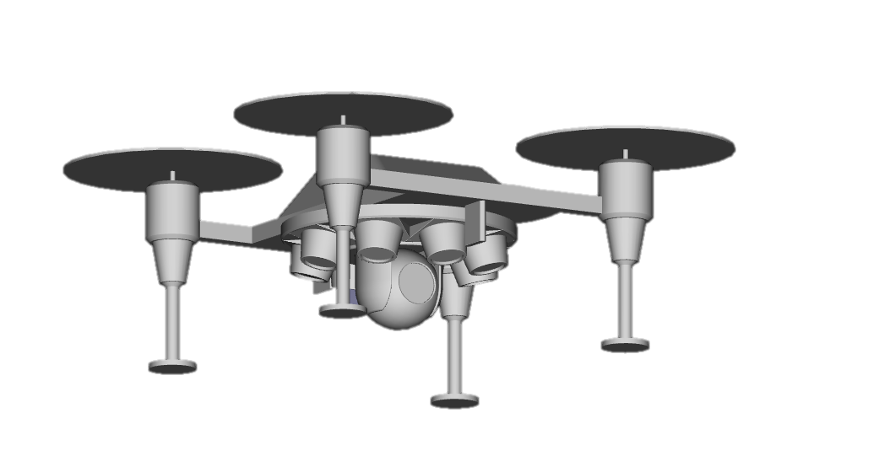
Air Vehicle Overview
Processing / electrical mounted in standardized faring
4 COTS DC electric motors + propellers
Lightweight composite frame with integrated landing gear
Payloads mounted using modular payload adapter system

Slide 4
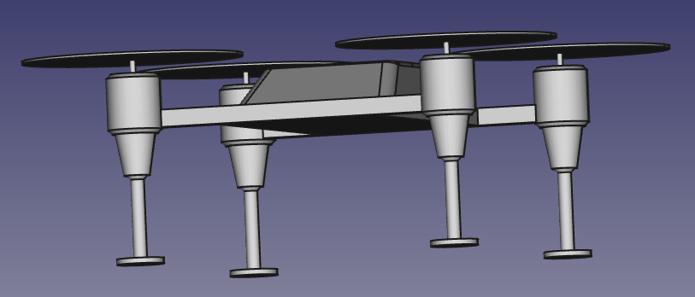
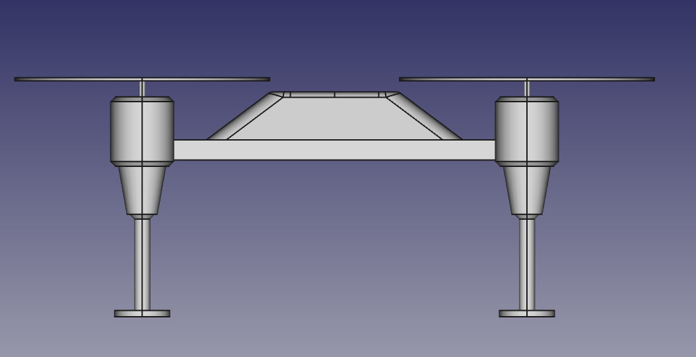
Basic Structure
Carbon fiber / aluminum composite primary structure
Extremely lightweight
Robust for deployed operations
Fiberglass faring to protect internal components
Integrated modular payload mounting system – enables rapid re-configuration
Extensive testing with Wanderer… deployed throughout the commercial industry

Slide 5
Flight Control Update
Requirement to eliminate foreign parts in the Flight Control System
Required hardware / software re-build
Hardware sourced in US, with identical specifications (including size, weight and power) to Chinese components
Full software scrub – original source code analyzed, all pre-compile binaries are trusted
Extensive analysis and testing shows that new FCS is functionally identical to legacy variant

Slide 6
Communications
COTS UHF quadcopter radio
Utilized in Wanderer and multiple other commercial UAVs
Extensive long range flying lineage – 20 km+ in industry applications
Shared maintenance / supply with Wanderer reduces costs
Some commercial applications have encryption – room for Nomad growth capability
Leveraging Wanderer control link software
Enables high reliability… proven over 15,000+ flight hours

